Slide 1
Chapter 4
Building an E-commerce Presence: Web Sites, Mobile Sites, and Apps
Copyright © 2014 Pearson Education, Inc. Publishing as Prentice Hall

Slide 2
Imagine Your E-commerce Presence
What’s the idea?
  Vision
  Mission statement
  Amazon: to become the largest marketspace on earth.
  Facebook: to make the world more open and connected
  Google: to organize the world’s information and make it globally accessible and useful
Copyright © 2014 Pearson Education, Inc. Publishing as Prentice Hall
Slide 4-<number>

Slide 3
Imagine Your E-commerce Presence (cont.)
Where’s the money?
  Business model(s):
    Portal, e-tailer, content provider, transaction broker, market creator, service provider, community provider
  Revenue model(s):
    Advertising, subscriptions, transaction fees, sales, and affiliate revenue
Copyright © 2014 Pearson Education, Inc. Publishing as Prentice Hall
Slide 4-<number>

Slide 4
Imagine Your E-commerce Presence (cont.)
Who and where is the target audience?
  Describing your audience
    Demographics
      Age, gender, income, location
    Behavior patterns (lifestyle)
    Consumption patterns (purchasing habits)
    Digital usage patterns
    Content creation patterns (blogs, Facebook)
    Buyer personas
Copyright © 2014 Pearson Education, Inc. Publishing as Prentice Hall
Slide 4-<number>

Slide 5
Imagine Your E-commerce Presence (cont.)
Characterize the marketplace
  Demographics
  Size, growth, changes
  Structure
    Competitors
    Suppliers
    Substitute products
Where is the content coming from?
  Static or dynamic?
Copyright © 2014 Pearson Education, Inc. Publishing as Prentice Hall
Slide 4-<number>

Slide 6
Imagine Your E-commerce Presence (cont.)
Know yourself—SWOT analysis
Develop an e-commerce presence map
Develop a timeline: Milestones
How much will this cost?
  Simple Web sites: up to $5000
  Small Web start-up: $25,000 to $50,000
  Large corporate site: $100,000+ to millions
Copyright © 2014 Pearson Education, Inc. Publishing as Prentice Hall
Slide 4-<number>

Slide 7
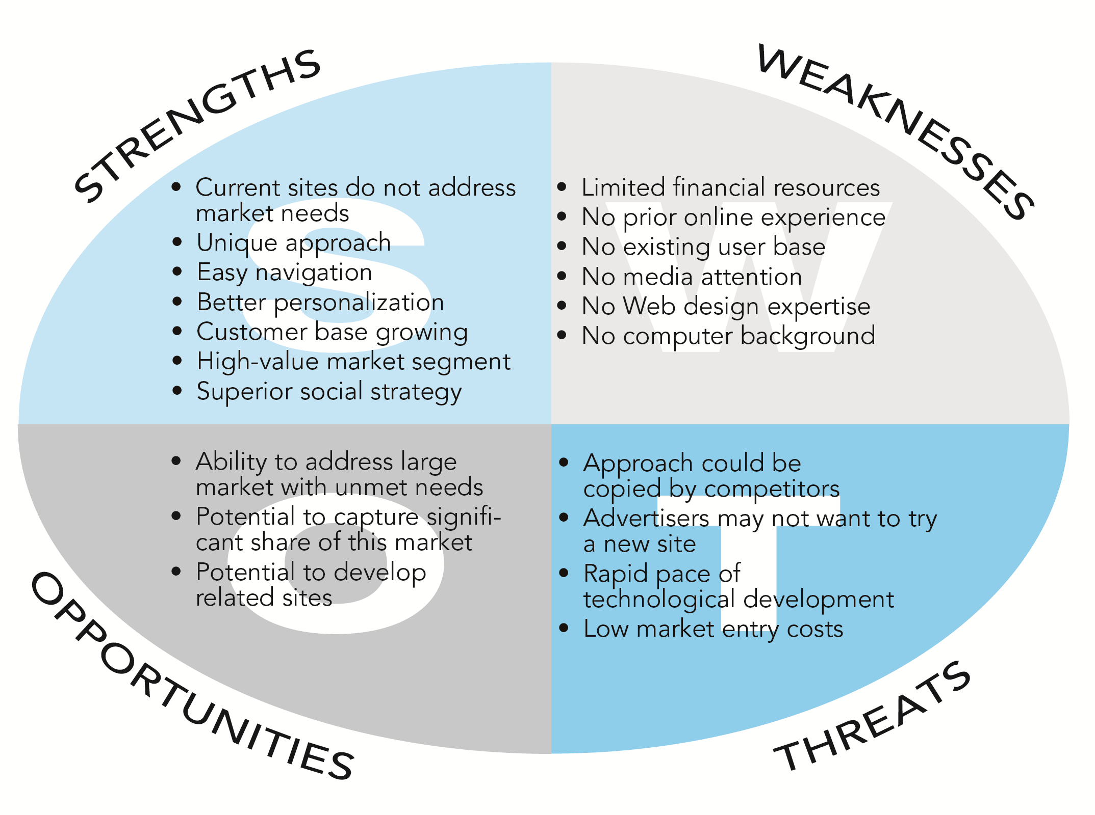
SWOT Analysis
Figure 4.1, page 189
Copyright © 2014 Pearson Education, Inc. Publishing as Prentice Hall
Slide 4-<number>

Slide 8
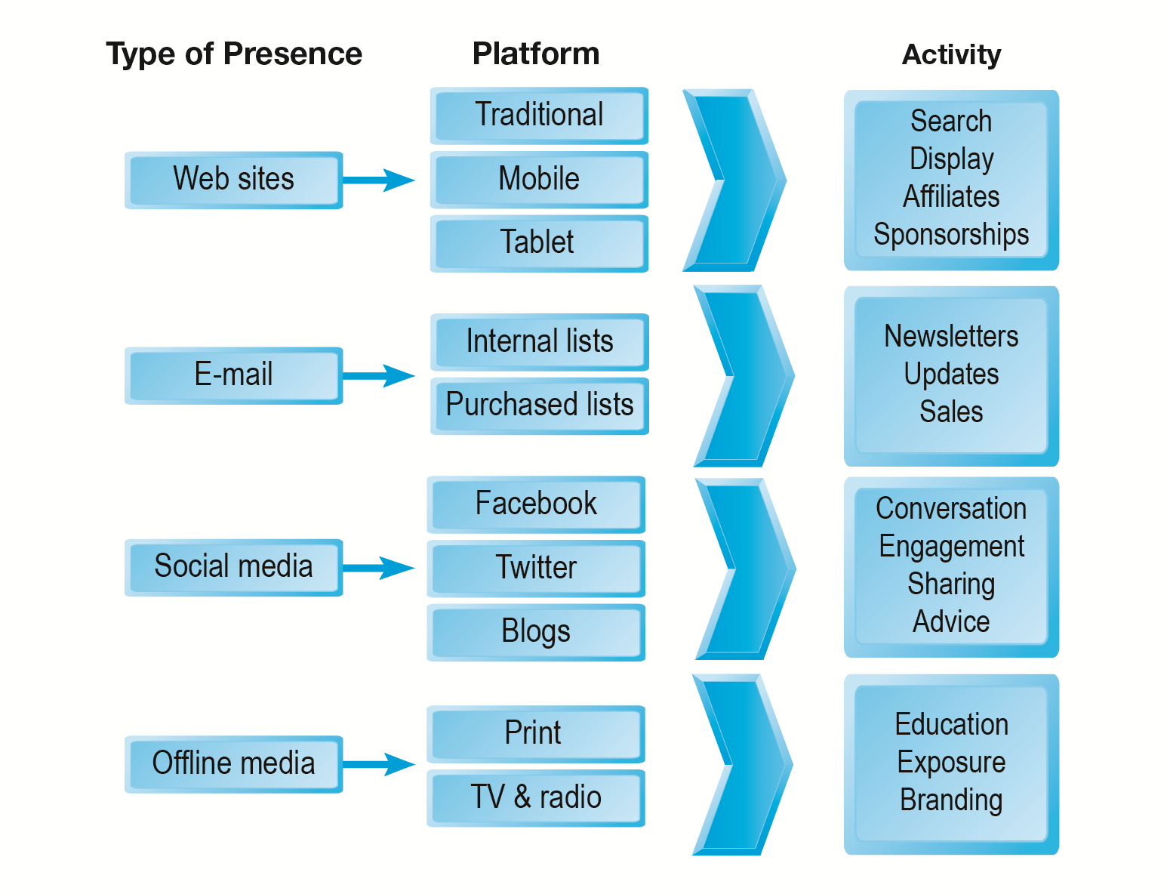
E-commerce Presence Map
Figure 4.2, page 190
Copyright © 2014 Pearson Education, Inc. Publishing as Prentice Hall
Slide 4-<number>

Slide 9
Building an E-commerce Site:
A Systematic Approach
Most important management challenges:
  Developing a clear understanding of business objectives
  Knowing how to choose the right technology to achieve those objectives
Copyright © 2014 Pearson Education, Inc. Publishing as Prentice Hall
Slide 4-<number>

Slide 10
Pieces of the Site-Building Puzzle
Main areas where you will need to make decisions:
  Human resources and organizational capabilities
    Creating team with skill set needed to build and manage a successful site
  Hardware/software
  Telecommunications
  Site design
Copyright © 2014 Pearson Education, Inc. Publishing as Prentice Hall
Slide 4-<number>

Slide 11
The Systems Development Life Cycle
Methodology for understanding business objectives of a system and designing an appropriate solution
Five major steps:
  Systems analysis/planning
  Systems design
  Building the system
  Testing
  Implementation
Copyright © 2014 Pearson Education, Inc. Publishing as Prentice Hall
Slide 4-<number>

Slide 12
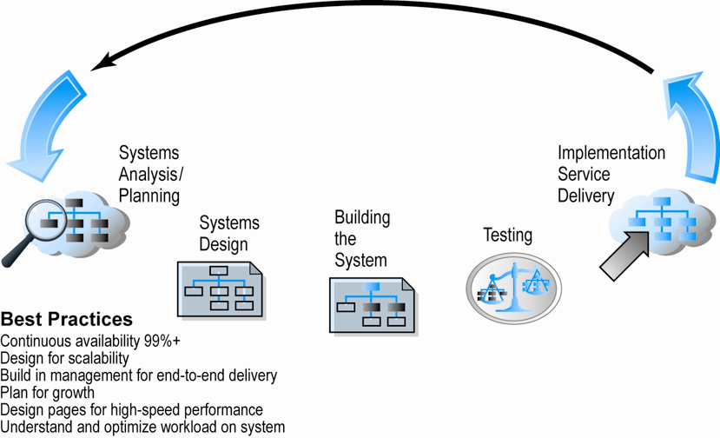
Web Site Systems Development Life Cycle
Figure 4.5, Page 194
Copyright © 2014 Pearson Education, Inc. Publishing as Prentice Hall
Slide 4-<number>

Slide 13
System Analysis/Planning
Business objectives:
  List of capabilities you want your site to have
System functionalities:
  List of information system capabilities needed to achieve business objectives
Information requirements:
  Information elements the system must produce in order to achieve business objectives
Copyright © 2014 Pearson Education, Inc. Publishing as Prentice Hall
Slide 4-<number>

Slide 14
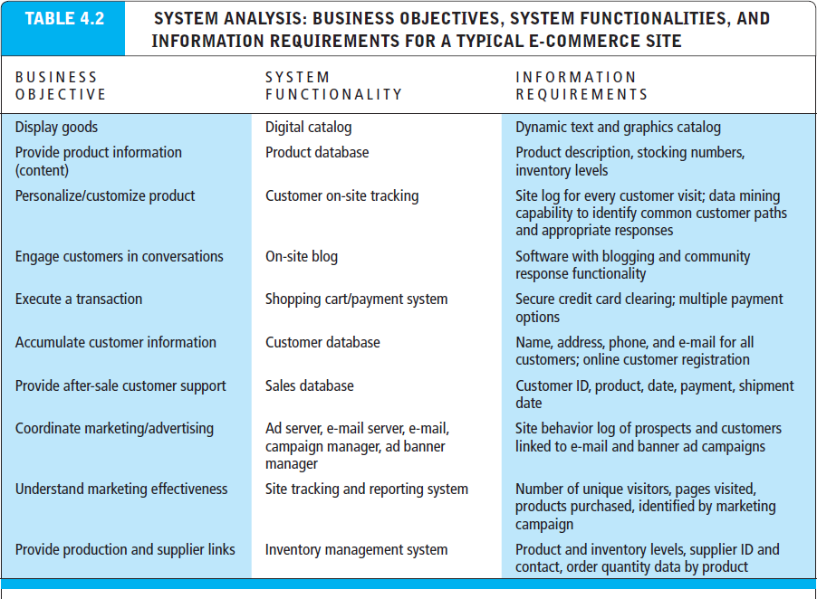
Table 4.2, page 195
Copyright © 2014 Pearson Education, Inc. Publishing as Prentice Hall
Slide 4-<number>

Slide 15
Systems Design:
Hardware and Software Platforms
System design specification:
  Description of main components of a system and their relationship to one another
Two components of system design:
  Logical design
    Data flow diagrams, processing functions, databases
  Physical design
    Specifies actual physical, software components, models, and so on
Copyright © 2014 Pearson Education, Inc. Publishing as Prentice Hall
Slide 4-<number>

Slide 16
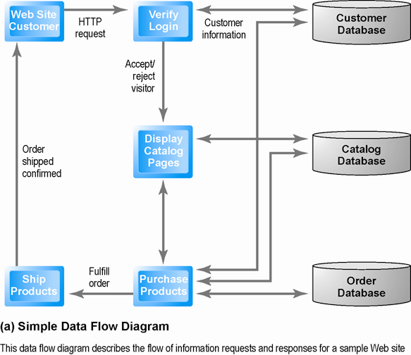
Logical Design for a Simple Web Site
Figure 4.6 (a), Page 197
Copyright © 2014 Pearson Education, Inc. Publishing as Prentice Hall
Slide 4-<number>

Slide 17
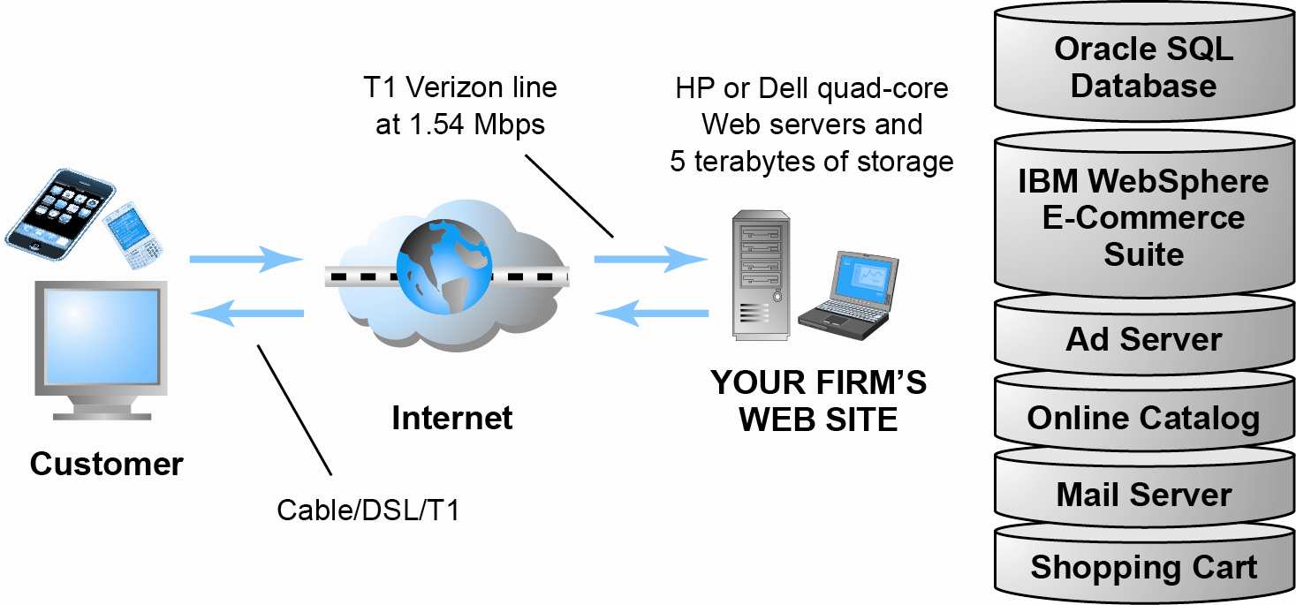
Physical Design for a Simple Web Site
Figure 4.6 (b), Page 197
Copyright © 2014 Pearson Education, Inc. Publishing as Prentice Hall
Slide 4-<number>

Slide 18
Build/Host Your Own vs. Outsourcing
Outsourcing: Hiring vendors to provide services involved in building site
Build own vs. outsourcing:
  Build your own requires team with diverse skill set; choice of software tools; both risks and possible benefits
Host own vs. outsourcing
  Hosting: Hosting company responsible for ensuring site is accessible 24/7, for monthly fee
  Co-location: Firm purchases or leases Web server (with control over its operation), but server is located at vendor’s facility
Copyright © 2014 Pearson Education, Inc. Publishing as Prentice Hall
Slide 4-<number>

Slide 19
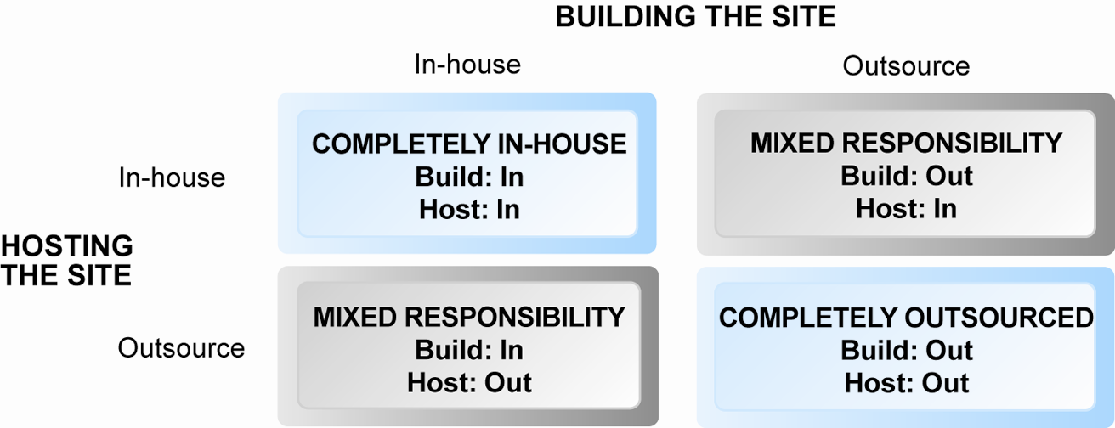
Choices in Building and Hosting
Figure 4.7 Page 198
Copyright © 2014 Pearson Education, Inc. Publishing as Prentice Hall
Slide 4-<number>

Slide 20
Testing, Implementation, and Maintenance
Testing
  Unit testing
  System testing
  Acceptance testing
Implementation and maintenance:
  Maintenance is ongoing
  Maintenance costs: Similar to development costs
  Benchmarking
Copyright © 2014 Pearson Education, Inc. Publishing as Prentice Hall
Slide 4-<number>

Slide 21
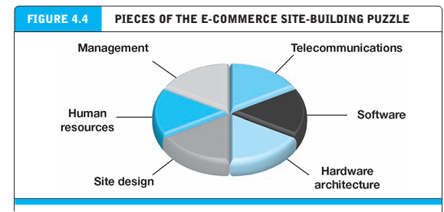
Copyright © 2014 Pearson Education, Inc. Publishing as Prentice Hall
Slide 4-<number>

Slide 22
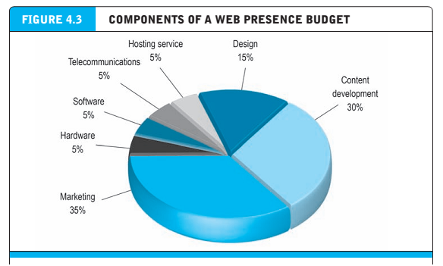
Copyright © 2014 Pearson Education, Inc. Publishing as Prentice Hall
Slide 4-<number>

Slide 23
Web Services and Open-Source Options
Options for small firms
  Hosted e-commerce sites
    Offer site building tools and templates
    Example: Yahoo’s Merchant Solutions
  Open-source merchant server software
    Enables you to build truly custom sites
    Requires programmer with expertise, time
  See table 4.6: OPEN SOURCE SOFTWARE OPTIONS
Copyright © 2014 Pearson Education, Inc. Publishing as Prentice Hall
Slide 4-<number>

Slide 24
The Hardware Platform
Hardware platform:
  Underlying computing equipment needed for
  e-commerce functionality
Objective:
  Enough platform capacity to meet peak demand without wasting money
Important to understand the factors that affect speed, capacity, and scalability of a site
Copyright © 2014 Pearson Education, Inc. Publishing as Prentice Hall
Slide 4-<number>

Slide 25
Right-Sizing Your Hardware Platform:
The Demand Side
Customer demand:
  Most important factor affecting speed of site
Factors in overall demand:
  Number of simultaneous users in peak periods
  Nature of customer requests (user profile)
  Type of content (dynamic vs. static Web pages)
  Required security
  Number of items in inventory
  Number of page requests
  Speed of legacy applications
SEE TABLE 4.7 PG 217: FACTORS IN RIGHT-SIZING E-COMMERCE PLATFORM
Copyright © 2014 Pearson Education, Inc. Publishing as Prentice Hall
Slide 4-<number>

Slide 26
Right-Sizing Your Hardware Platform:
The Supply Side
Scalability:
  Ability of site to increase in size as demand warrants
Ways to scale hardware:
  Vertically
    Increase processing power of individual components
  Horizontally
    Employ multiple computers to share workload
  Improve processing architecture
Copyright © 2014 Pearson Education, Inc. Publishing as Prentice Hall
Slide 4-<number>

Slide 27
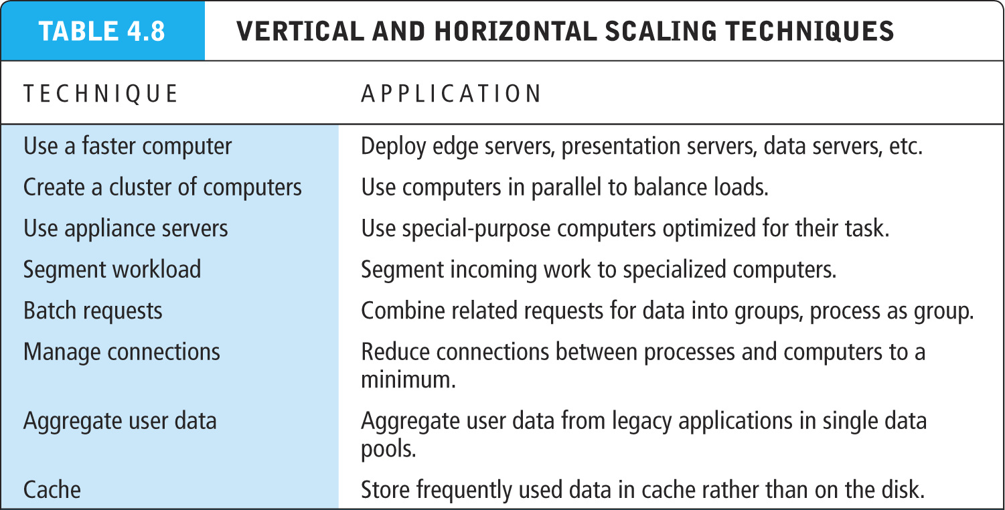
Table 4.8, Page 219
Copyright © 2014 Pearson Education, Inc. Publishing as Prentice Hall
Slide 4-<number>

Slide 28
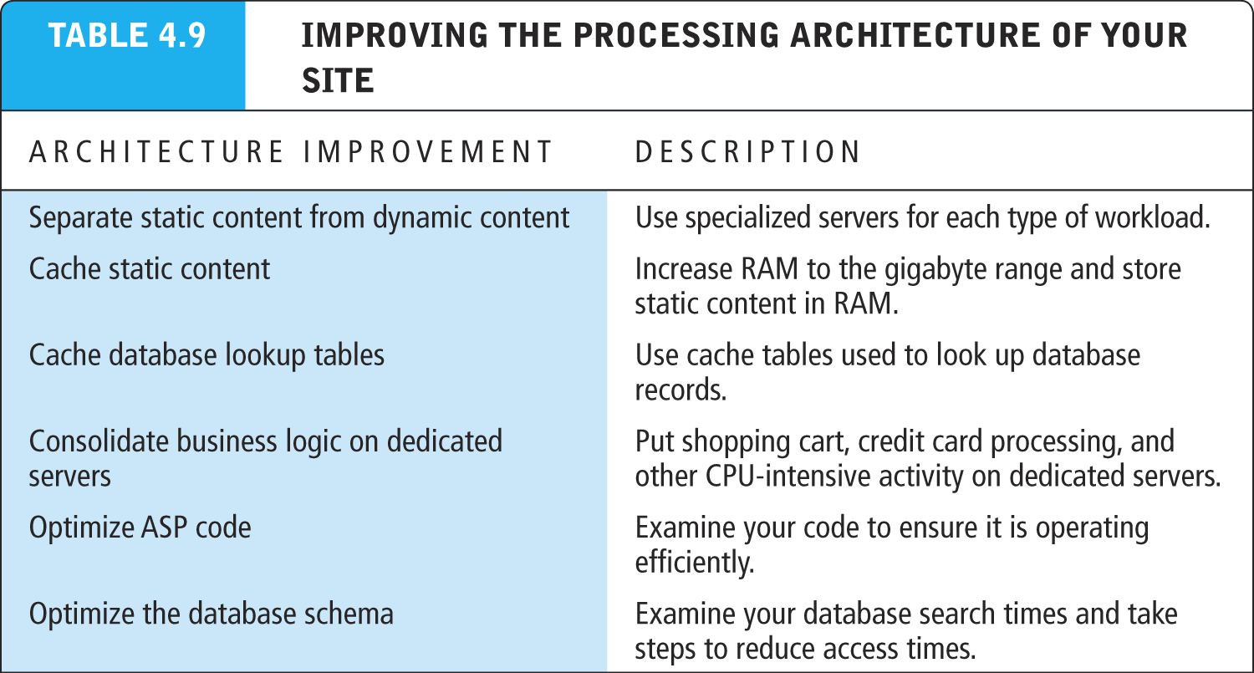
Table 4.9, Page 220
Copyright © 2014 Pearson Education, Inc. Publishing as Prentice Hall
Slide 4-<number>

Slide 29
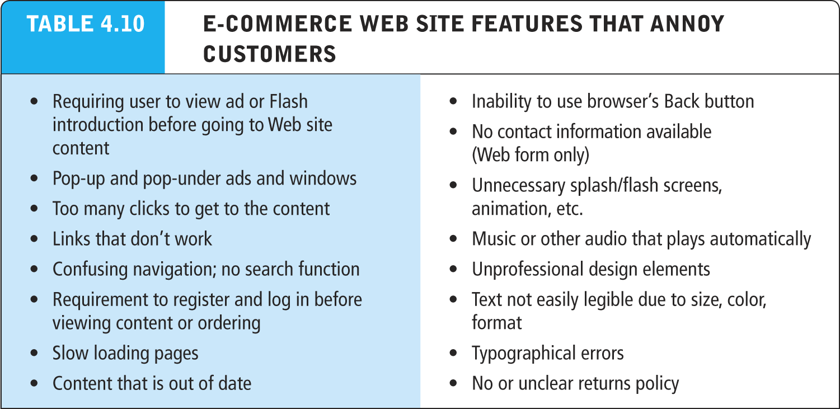
Table 4.10, Page 221
Copyright © 2014 Pearson Education, Inc. Publishing as Prentice Hall
Slide 4-<number>

Slide 30
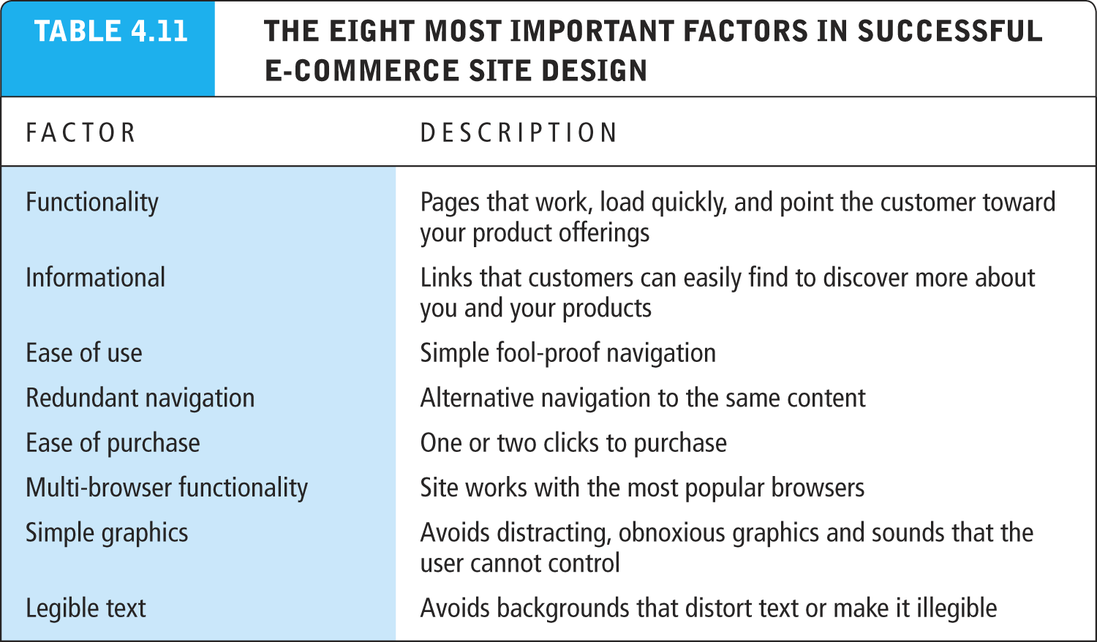
Table 4.11, Page 222
Copyright © 2014 Pearson Education, Inc. Publishing as Prentice Hall
Slide 4-<number>

Slide 31
Tools for Interactivity and
Active Content
CGI (Common Gateway Interface)
ASP (Active Server Pages)/ASP.NET
Java, JSP, and JavaScript (Sun)
ActiveX and VBScript (Microsoft)
ColdFusion (Adobe)
Web 2.0 design elements:
  Widgets (small pieces of programming code)
  mashups (functionality and data from one program used in another)
Copyright © 2014 Pearson Education, Inc. Publishing as Prentice Hall
Slide 4-<number>

Slide 32
Developing a Mobile Web Site and Building Mobile Applications
Three types of m-commerce software
  Mobile Web site
    Responsive Web design
  Mobile Web app built for a mobile web browser of a smart device (phone, tablet)
  Native app designed specifically for mobile device
Planning and building mobile presence
  Use systems analysis/design to identify unique and specific business objectives
Copyright © 2014 Pearson Education, Inc. Publishing as Prentice Hall
Slide 4-<number>

Slide 33
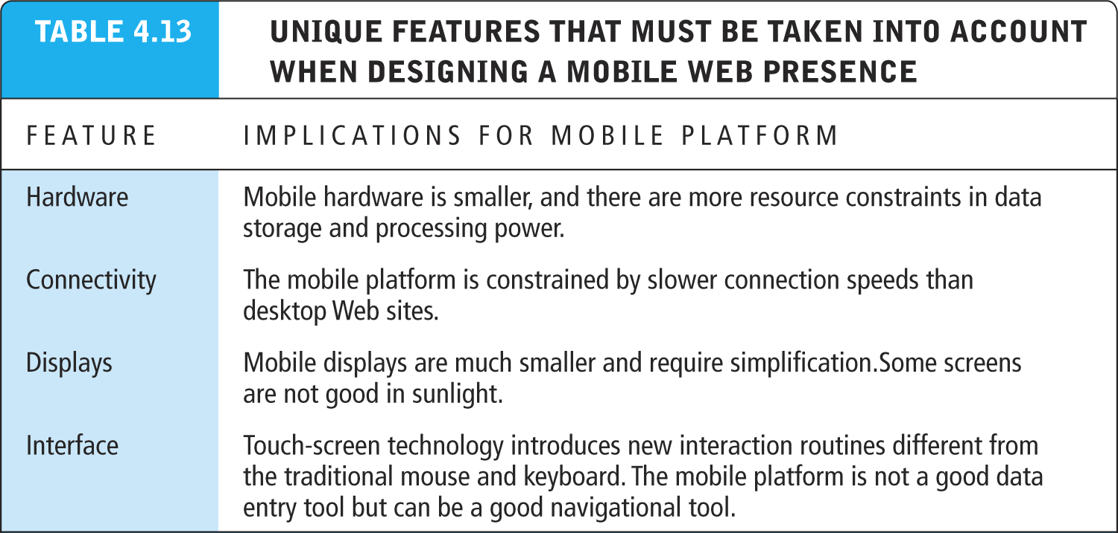
Table 4.13, Page 231
Copyright © 2014 Pearson Education, Inc. Publishing as Prentice Hall
Slide 4-<number>

Slide 34
Developing a Mobile Web Presence
Design considerations
  Platform constraints: Smartphone/tablet
Performance and cost
  Mobile Web site:
    Least expensive
  Mobile app:
    Can utilize browser API
  Native app:
    Most expensive; requires more programming
Copyright © 2014 Pearson Education, Inc. Publishing as Prentice Hall
Slide 4-<number>

